Slide 1
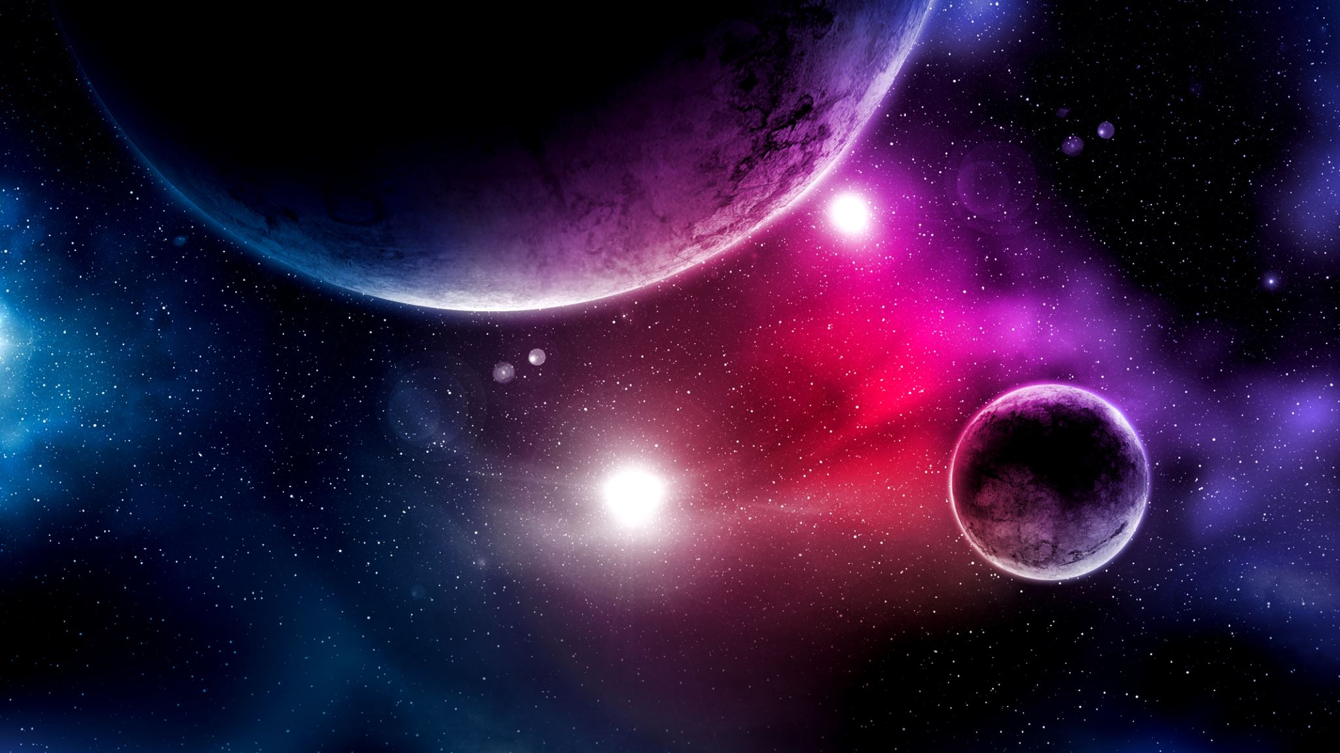
Evaluation of Universe
Amir Ali

Slide 2

Outline
Introduction
Main Part
The Big Bang Theory
Dark Ages
Star Formation
Galaxy Formation
Black Holes
Expansion Theory

Slide 3
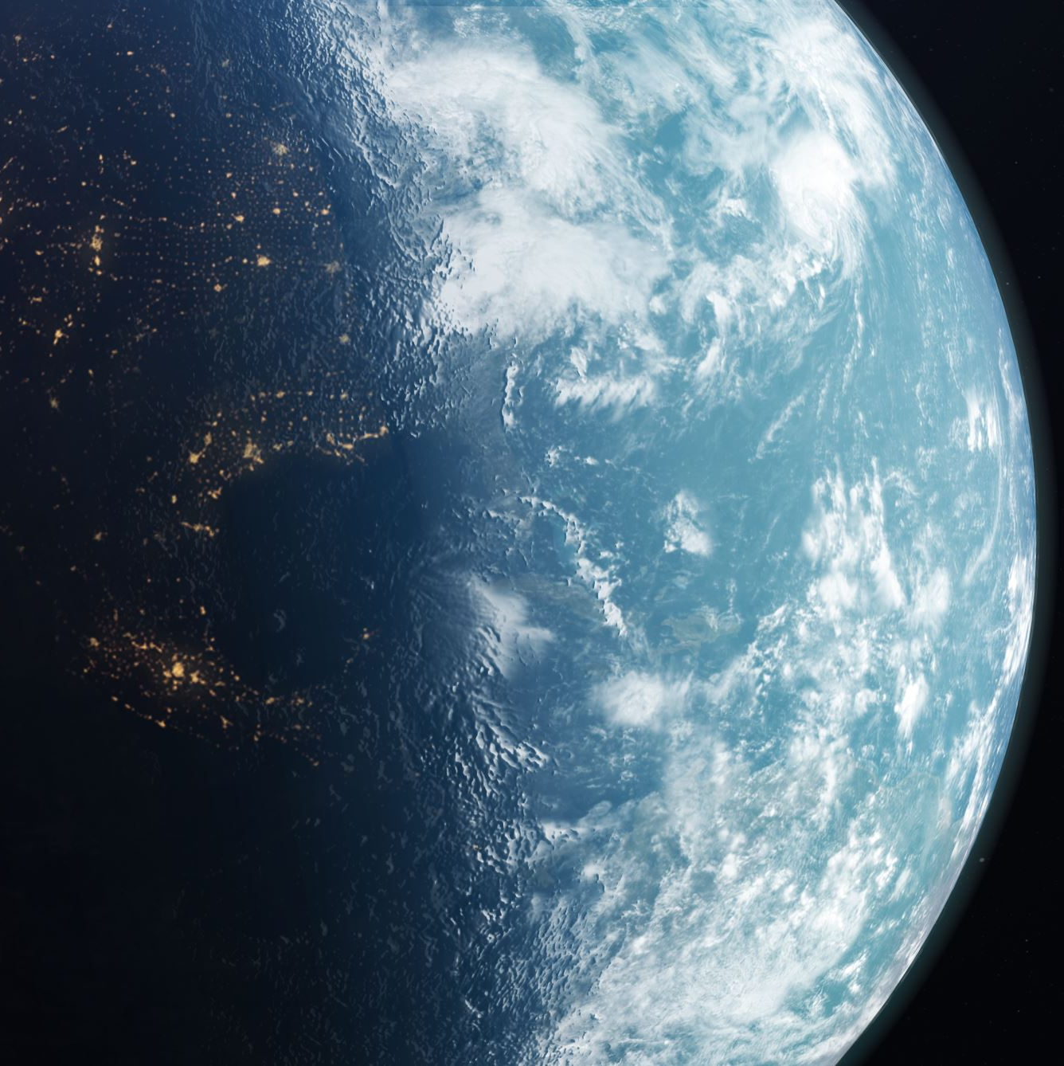
Introduction
The evaluation of the universe involves the scientific study
Scientists use variety of tools & methods to explore the universe
The study of the universe has contributed in many fields
By evaluating the universe, we are gaining a deeper understanding of the natural world and our place in it
The evaluation of the universe is important because it helps us comprehend the world around us and its complexities.

Slide 4

Main Theory
The main theory put forward to explain the origin and evaluation of the universe are:
The Big Bang Theory
However, Big Bang Theory is the generally accepted Theory explaining the evolution of the universe.

Slide 5
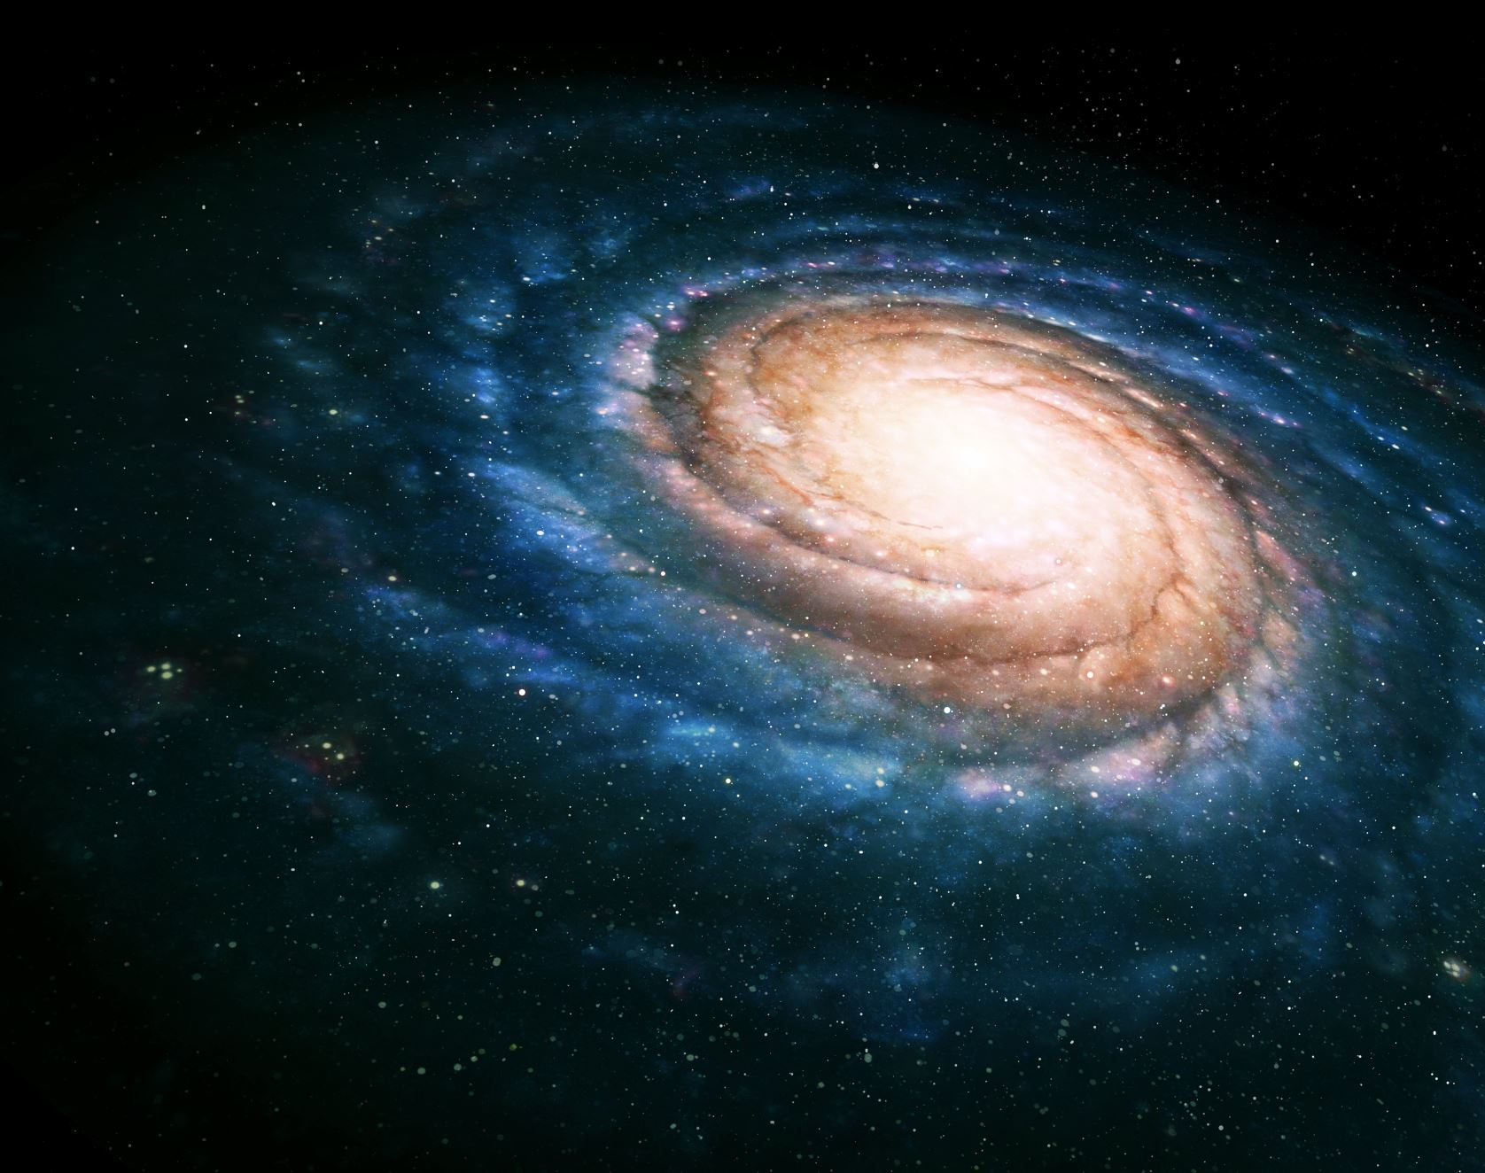
Big Bang Theory
The Big Bang Theory is a scientific model that explains the origin and evolution of the universe.
The Big Bang is Known as a singularity. A singularity is a zone of infinite density such as the cores of black holes.
The Big Bang theory based on beginning of the universe that is a branch of the field of science called cosmology.

Slide 6
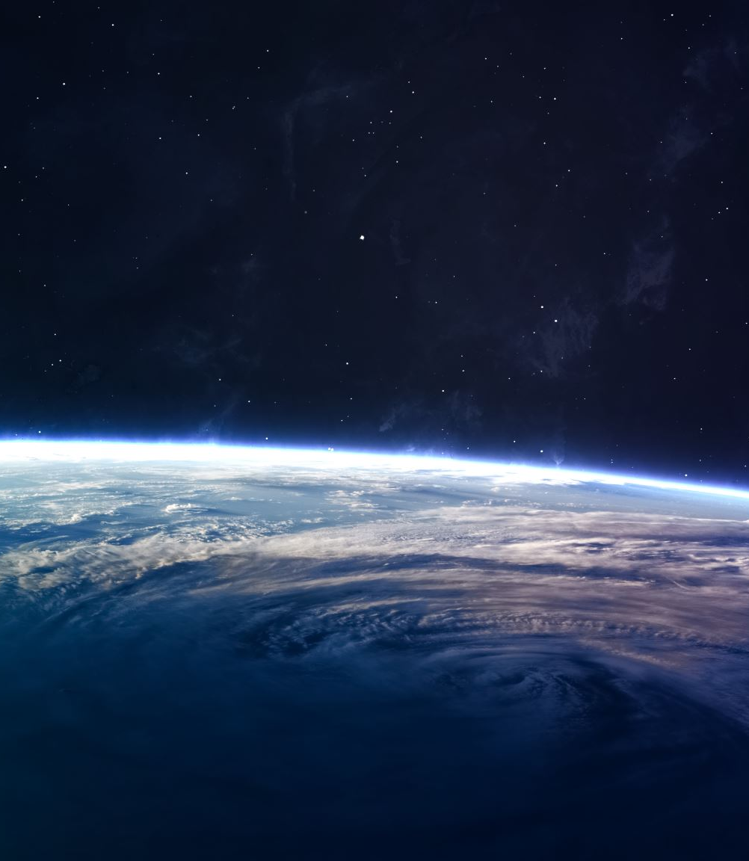
Origin of the Theory
Georges Lemaitre and the Single Atom
Edwin Hubble and Observational Support
Contributions of Arno Penzias and Robert Wilson

Slide 7
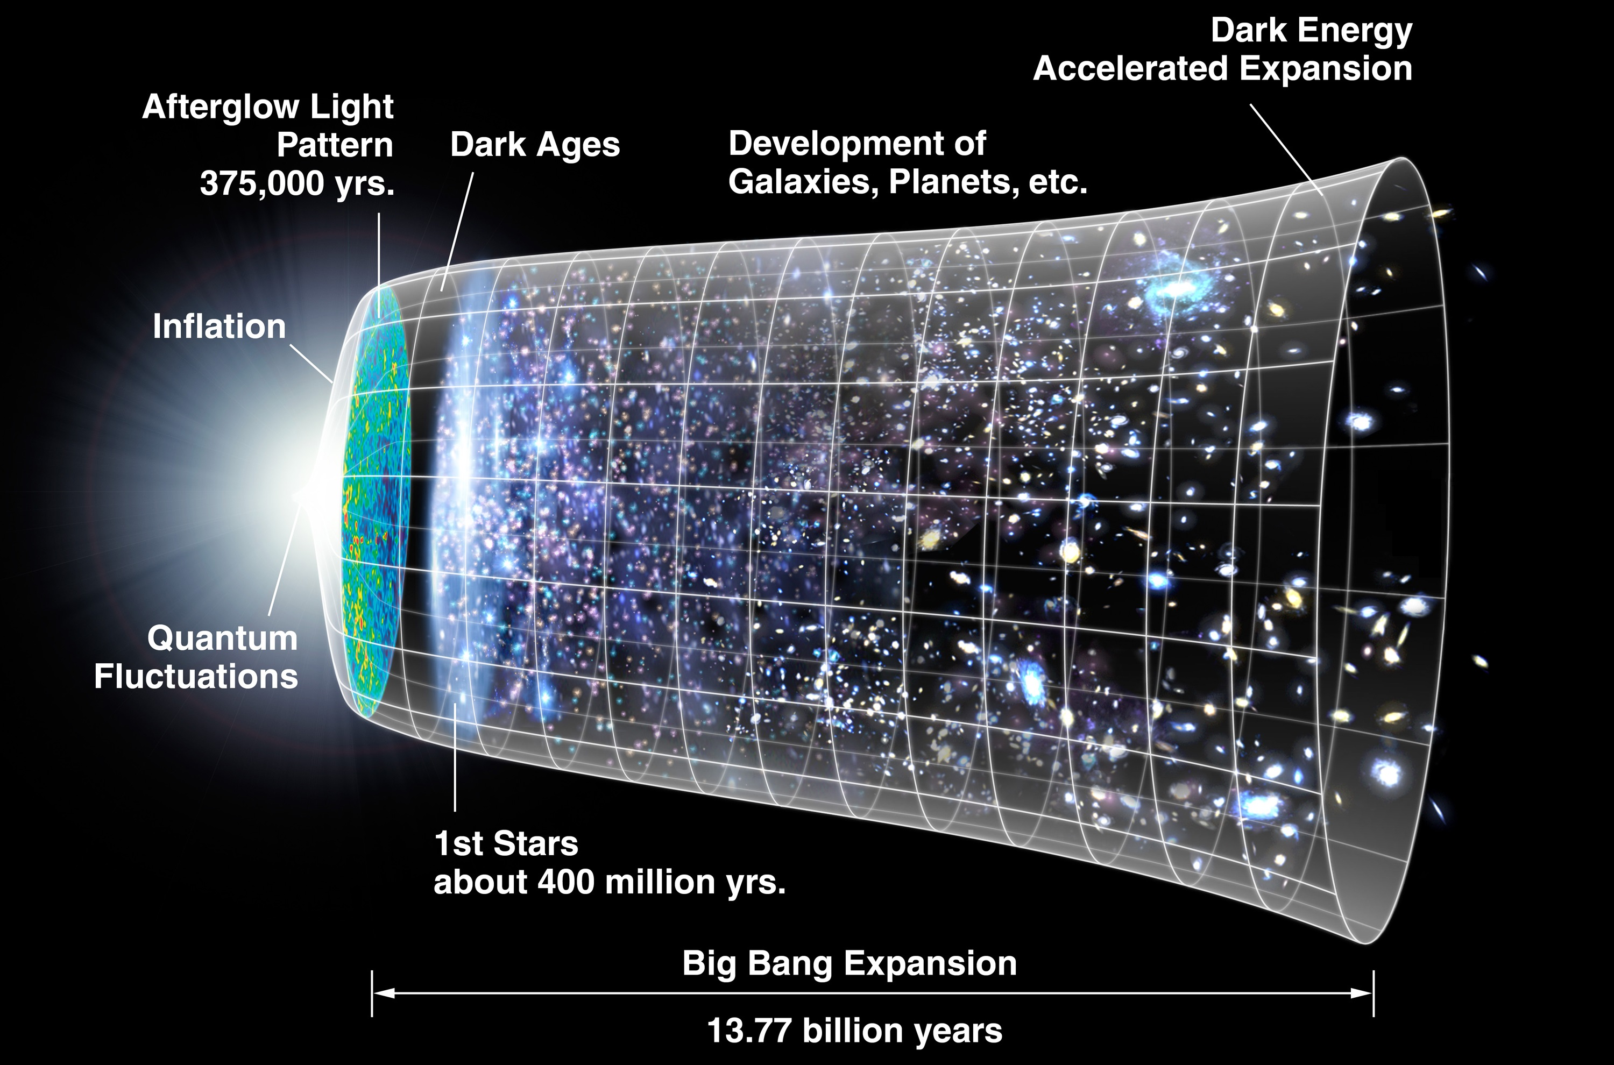
When it Happened
Common belief in today’s scientific industry suggests that the beginning of our universe, the Big Bang, started around 13.7 billion years ago.

Slide 8
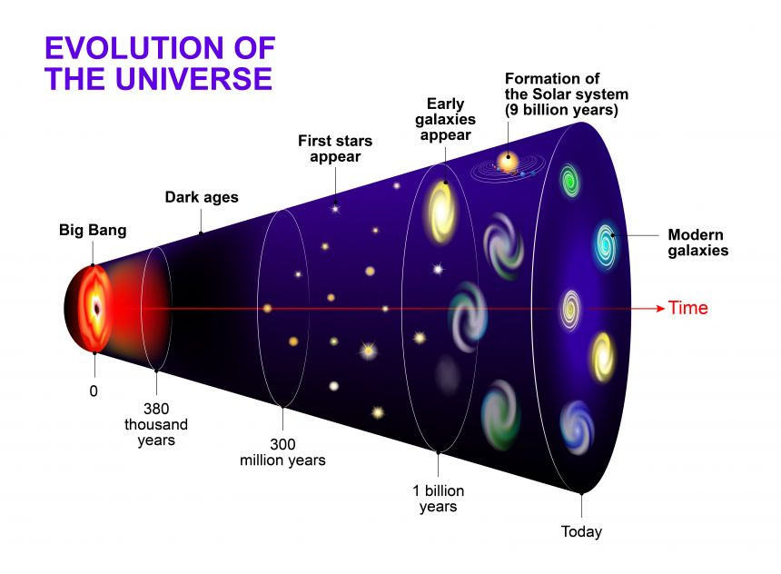
What Happened
It is believed that the Big Bang, once started, got bigger and cooler, going from very tiny and very hot to the modern universe we lived in today.

Slide 9
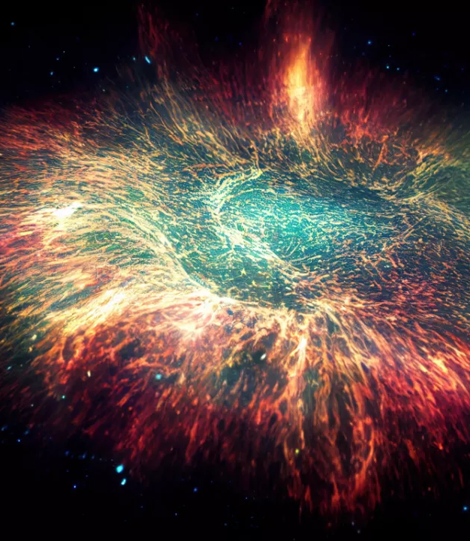
Evidence
The Universe must have a beginning.
Galaxies appear to be moving away from us.
The Cosmic Microwave Background Radiation (CMB):

Slide 10
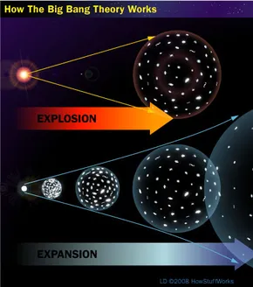
Common Misconceptions
People often tend to think of a giant explosion when really the Big Bang was and continues to be an expansion.
Instead of thinking of it as a balloon popping; imagine it as a balloon expanding and filling with air continuing on and on to the size of our universe.

Slide 11
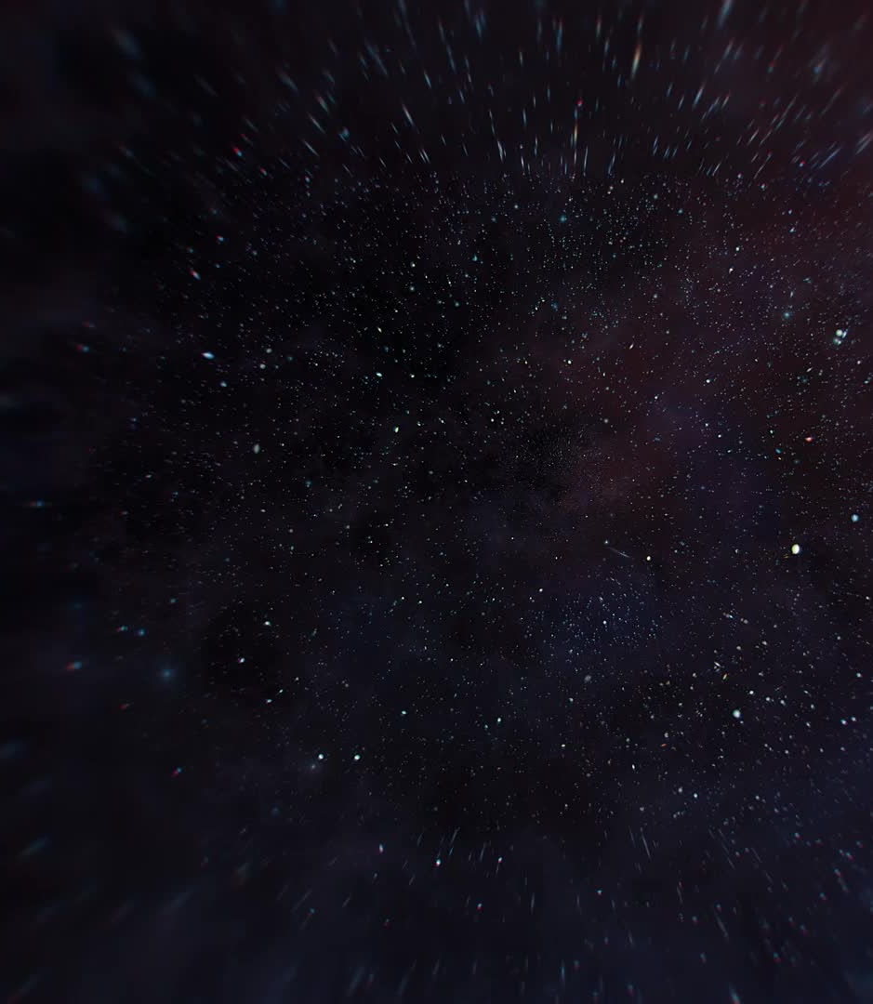
Dark Ages
What is Dark Ages?
Duration
Cause
Formation of Neutral Hydrogen
Dark and Lightless Universe
Observational challenge
End of the Dark Ages
Importance of Studying the Dark Ages

Slide 12
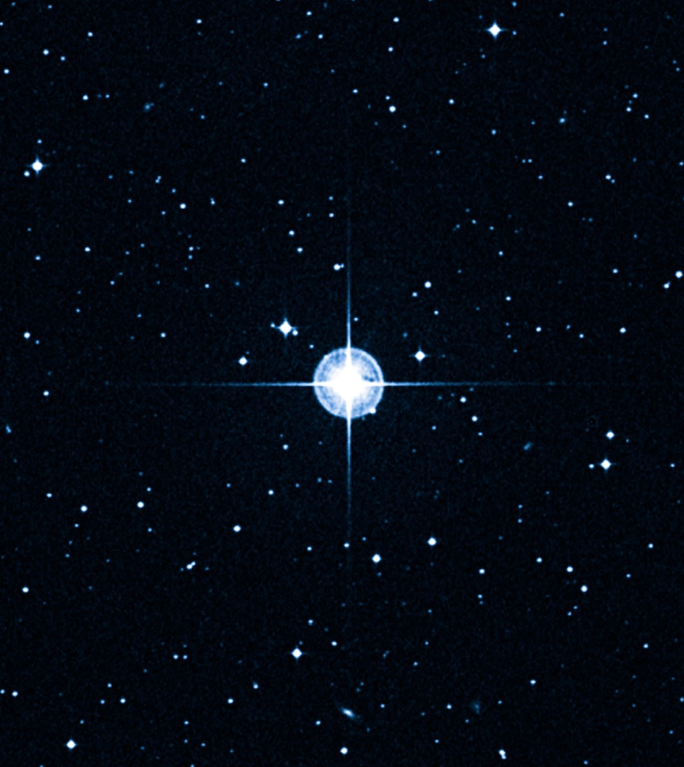
First Star Appear
The first stars in the universe formed during the cosmic dawn, after the Dark Ages.
They are estimated to have formed about 100 to 200 million years after the Big Bang.
These stars were likely massive and short-lived.
Their explosive deaths contributed to the enrichment of the universe with heavier elements.
The study of the first stars is important for understanding the early universe, the formation of galaxies, and the nature of dark matter and dark energy.

Slide 13
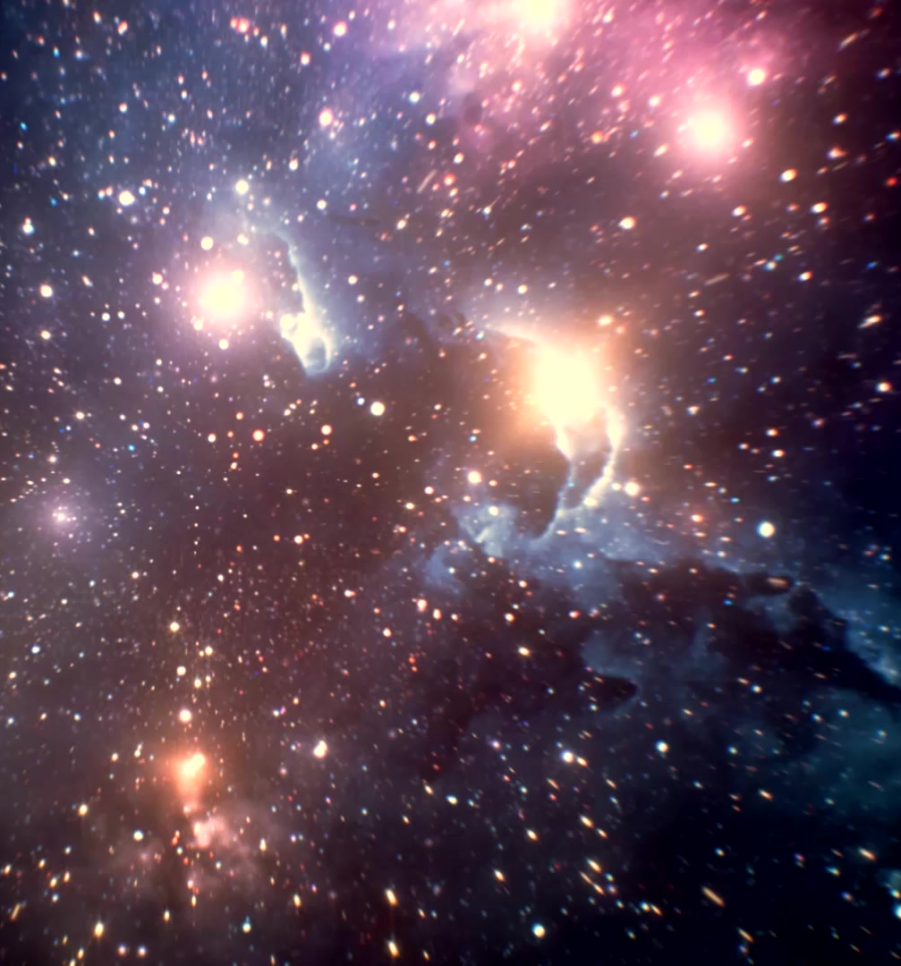
How happened
The first stars formed through a process called gravitational collapse.
After the Dark Ages, gravity started pulling gas together and the gas cloud became denser and hotter.
Nuclear fusion was ignited in the center of the cloud when the temperature and pressure became high enough, creating the first star.
These stars were much larger and brighter than typical stars we see today, and were also shorter-lived.

Slide 14
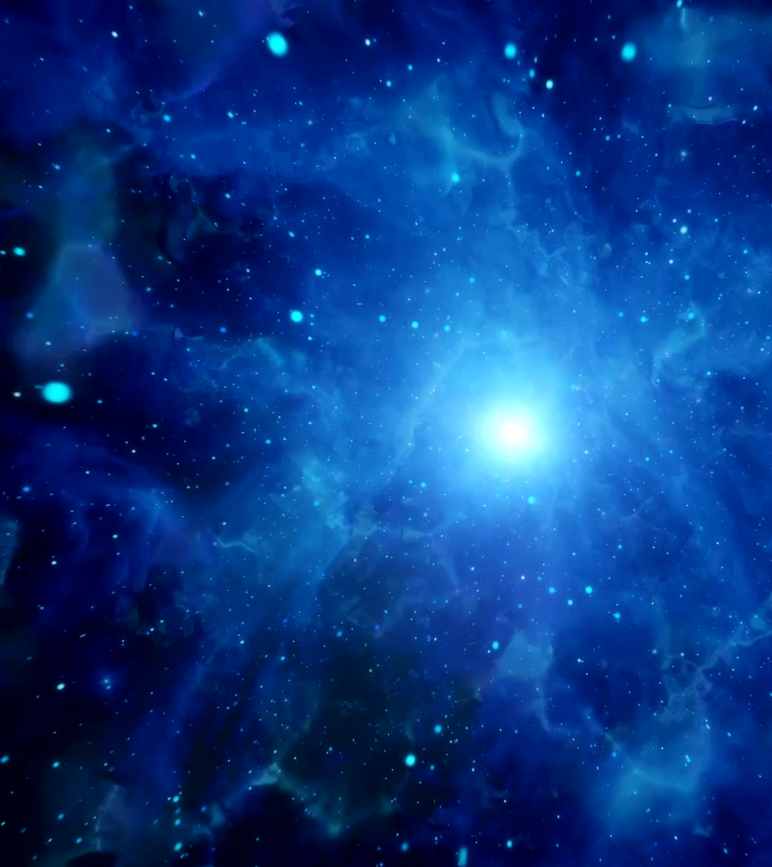
After the Formation of the First Stars
The first stars began to produce light and heat, which re-ionized the gas that filled the universe.
This process is called reionization, and it marked the end of the Dark Ages.
As the first stars died and exploded, they produced heavy elements that were scattered throughout the universe.
These elements eventually formed the building blocks for future generations of stars and planets.
Galaxies began to form and evolve over time.
The universe continued to expand and change.

Slide 15
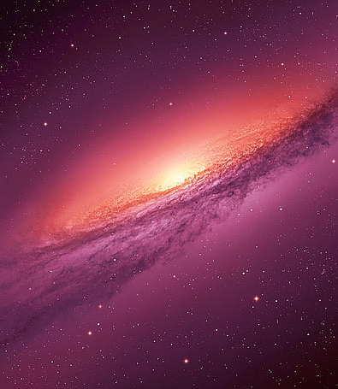
Early Galaxies Appear
As the first stars formed and died, they produced heavy elements that were scattered throughout the universe.
These heavy elements provided the raw materials for the formation of the first galaxies.
Gravity played a major role in the formation of early galaxies, causing clouds of gas and dust to clump together and eventually form stars.
As more stars formed, they began to cluster together and form galaxies.
The earliest galaxies were much smaller and less organized than the galaxies we see today.
Over time, galaxies continued to evolve and grow, merging with each other and forming the large, complex structures we see in the universe today.

Slide 16
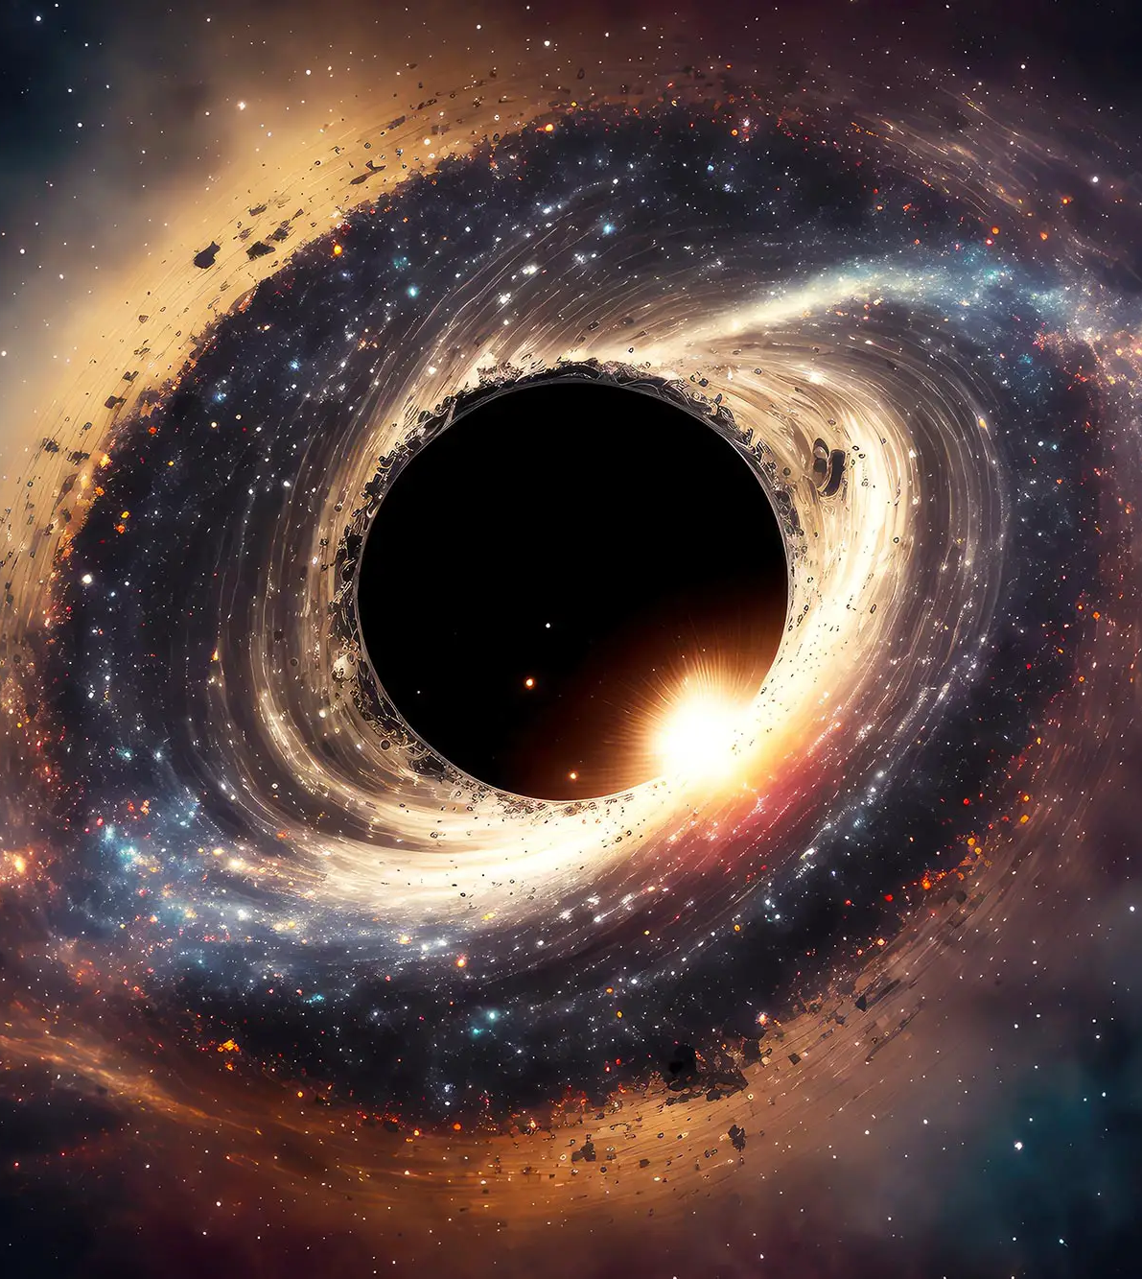
Black Hole
A black hole is a region in space where gravity is so strong that nothing, not even light, can escape from it.
Black holes are formed when massive stars collapse in on themselves at the end of their life cycle.
There are three types of black holes: stellar black holes, intermediate black holes, and supermassive black holes.
Stellar black holes are the most common type and are formed from the collapse of stars that were at least three times more massive than the Sun.
Intermediate black holes are believed to be formed from the collision and merging of multiple stellar black holes.
Supermassive black holes are found at the center of most galaxies, including our own Milky Way, and are believed to have formed from the merging of multiple intermediate black holes.

Slide 17
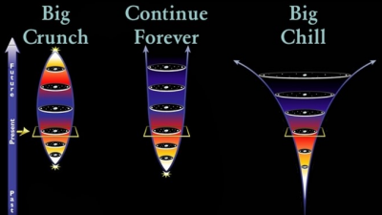
Theories of Expansion
There are three different theories of what will happen with our universe and how it expands.
The Big Crunch
Continuing Forever
The Big Chill

Slide 18
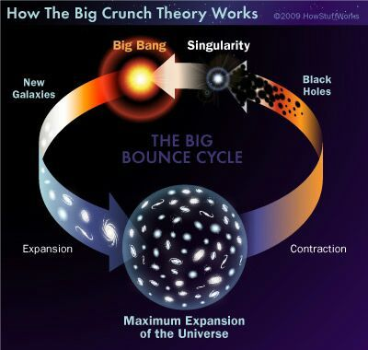
The Big Crunch
The Big Crunch is a situation that scientists predict will happen.
The Big Crunch explains how the universe will end.
The theory states that the universe will not continue to expand forever.
Eventually the expansion of the universe will stop and the universe will collapse on itself forming a gigantic black hole.

Slide 19
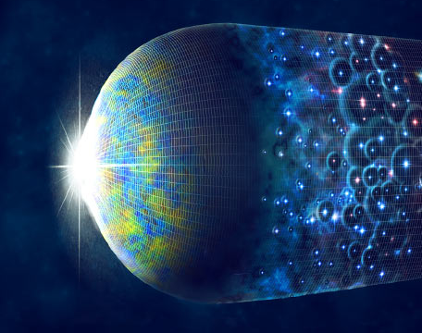
Continuing Forever
If the universe is less dense than the “critical dense” then it will continue to expand forever.
If the universe is dense then the universe collapses on itself which is called Big Crunch.
The Critical density is 10^-30 grams per cubic centimeter.

Slide 20
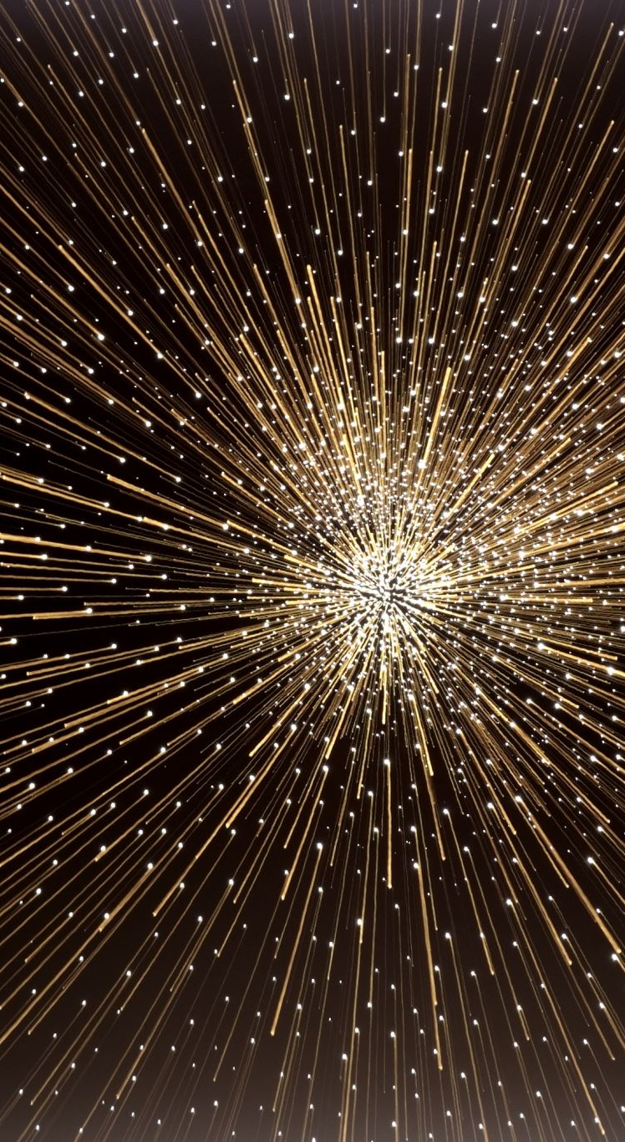
The Big Chill
The Big Chill is a theory that states the universe will continue expanding and eventually run down to a state of zero energy.
The temperature will reach very close to absolute zero where the only remaining things would be burnt-out stars, cold dead planets, and black

Slide 21

Reference
Planck Collaboration. (2018). Planck 2018 results. VI. Cosmological parameters. Astronomy & Astrophysics, 641, A6. https://doi.org/10.1051/0004-6361/201833910
Riess, A. G., et al. (2019). Large Magellanic Cloud Cepheid Standards Provide a 1% Foundation for the Determination of the Hubble Constant and Stronger Evidence for Physics Beyond ΛCDM. The Astrophysical Journal, 876(1), 85. https://doi.org/10.3847/1538-4357/ab1422
Liddle, A. (2015). An Introduction to Modern Cosmology. Wiley.
Peebles, P. J. E. (1993). Principles of Physical Cosmology. Princeton University Press.
Guth, A. H. (1997). The Inflationary Universe: The Quest for a New Theory of Cosmic Origins. Basic Books.
Carroll, S. M. (2004). Spacetime and Geometry: An Introduction to General Relativity. Addison-Wesley.
Hawking, S. (1998). A Brief History of Time. Bantam.
Greene, B. (2005). The Fabric of the Cosmos: Space, Time, and the Texture of Reality. Alfred A. Knopf.

Slide 22
Thank You

